Slide 1
Hotel Booking Demand & Cancellation Analysis
Uncovering booking trends and cancellation behavior to drive data-informed hotel strategies.
~ Presented by: Dhruv

Slide 2
Table of contents
Project Setup & Data Understanding
Data Cleaning & Feature Preparation
Dataset import, structure & objectives
Data fixing & derived metrics
Exploratory Analysis & KPI Development
Dashboard Visualization & Strategic Insights
SQL trends & performance metrics
Visual storytelling & business insights

Slide 3
01
Project Setup & Data Understanding
Defining the objective, setting up SQL environment, and exploring the dataset structure.

Slide 4
Project Setup & Data Understanding
Objective
To analyze hotel booking patterns and identify key factors driving demand and cancellations using SQL and Power BI.
The goal is to transform raw booking data into actionable insights that help optimize revenue, occupancy, and customer retention.
Dataset Overview
Source: Hotel Booking Dataset (City Hotel & Resort Hotel)
Records: ~119,000 bookings
Time Range: July 2015 to August 2017
Key Attributes: Booking details, customer demographics, stay duration, lead time, cancellation status, and revenue metrics

Slide 5
Project Setup & Data Understanding
Tools & Technologies
Tool | Purpose
Excel | Initial exploration and validation
MySQL | Data cleaning, transformation & KPI derivation
Power BI | Visualization and interactive dashboard creation
Setup & Structure
Created a structured SQL database named hotel_analysis.
Loaded main dataset: hotel_bookings
Added lookup tables for market segments, distribution channels, and country–continent mapping.
Validated data accuracy through row counts, sample checks, and field consistency tests.

Slide 6
02
Data Cleaning & Feature Preparation
Transforming raw data into structured form by handling nulls and creating analytical features.

Slide 7

Data Cleaning & Preparation Process
Objective
To ensure accuracy and consistency by performing column-wise cleaning, null handling, and sanity checks for analytical readiness.
Key Cleaning Steps
Guest & Stay Details:
Fixed missing or invalid guest counts (adults, children, babies) and removed zero/negative stay durations.
Booking Source Classification:
Derived booking_source, source_id, agent_flag, and company_flag to categorize bookings as Agent, Company, or Direct.
Country & Continent Mapping:
Replaced blank or null country values with 'Unknown' and mapped each to its continent via lookup table.

Slide 8
Data Cleaning & Preparation Process
Key Cleaning Steps
Financial & Duration Checks:
Corrected negative adr values and validated lead_time ranges to remove unrealistic entries.
Repeat Guest Validation:
Cross-checked is_repeated_guest with previous booking history and added logical flags for repeat consistency.
Sanity & Consistency Tests:
Verified distinct values in key fields (hotel, meal, deposit_type, market_segment) and ensured no nulls in critical columns.

Slide 9
Feature Engineering & Derived Columns
Objective: To enhance the dataset with analytical columns that simplify trend detection, performance measurement, and KPI computation.
Key Derived Features
Arrival & Reservation Dates:
->Combined day, month, and year columns into a single arrival_date.
->Converted reservation_status_date into a valid SQL date (reservation_status_dt).
->Ensured both fields fall within the dataset range (Jul 2015 – Aug 2017).
Stay & Guest Metrics:
->Created stay_length = stays_in_weekend_nights + stays_in_week_nights.
      ->Created guest_count = adults + children + babies.
->Used for occupancy and group size analysis.
Cancellation Flag:
->Derived binary column cancellation_flag from is_canceled.
      ->Simplifies cancellation rate calculations in SQL and Power BI.

Slide 10
Feature Engineering & Derived Columns
Key Derived Features
Booking Date Calculation:
->Added booking_date = arrival_date – lead_time.
->Enables time-gap and booking lead-time trend analysis.
Season Classification:
->Categorized months into Winter, Spring, Summer, Autumn.
      ->Helps identify seasonal demand and occupancy variation.
Clean Repeat Guest Indicator :
->Refined repeat_status_clean using logical checks on historical bookings.
      ->Ensures accurate tracking of loyal and returning customers.
Data Validation Summary:
Ensured all derived fields had valid ranges and no nulls, confirming dataset readiness for KPI analysis.

Slide 11
03
Exploratory Analysis & KPI Development
Deriving key performance indicators and uncovering booking trends using SQL analysis.

Slide 12

Objective & KPI Framework
Objective
To explore hotel booking data using SQL-based aggregations and derive meaningful KPIs that highlight booking patterns, guest behavior, revenue performance, and cancellation risks.
KPI Framework:
KPIs were organized into four analytical groups to ensure structured insight generation across all business dimensions:
Booking Volume & Trends – Demand analysis over time and seasons.
Profit & Revenue Metrics – Financial performance tracking.
Guest Behavior KPIs – Understanding booking behavior and planning patterns.
Cancellation Intelligence – Identifying patterns and root causes of cancellations.

Slide 13
Group A & Group B KPIs
Group A – Booking Volume & Trends
Focus: Measure overall booking demand and seasonality
Total Bookings: Total ~119K bookings analyzed.
Bookings per Year: Slight increase from 2015 → 2016, minor dip in 2017.
Bookings per Month: Peak bookings during July–August (holiday season).
Bookings per Season: Summer and Spring showed highest demand.
➡ Insight: Booking activity peaks during summer months – confirming strong seasonal demand patterns.
Group B – Profit & Revenue Metrics
Focus: Evaluate hotel profitability and ADR performance.
Average Daily Rate (ADR): Higher for City Hotels; consistent growth across months.
Revenue Estimation: City Hotels contribute higher overall revenue volume.
Revenue by Hotel Type: Resort Hotels show steadier ADR but lower booking count.
➡ Insight: City Hotels drive higher revenue through volume, while Resort Hotels maintain stable ADR across seasons.

Slide 14
Group C & Group D KPIs
Group C – Guest Behavior KPIs
Focus: Analyze guest stay duration and planning behavior.
Average Stay Length: 3–4 nights on average; slightly longer for Resort stays.
Guest Count Distribution: Mostly adult travelers; few family bookings with children.
Lead Time Patterns: Average lead time ~104 days; Resort guests book earlier.
➡ Insight: Guests plan vacations well in advance, especially for resorts, showing planned leisure travel behavior.
Group D – Cancellation Intelligence
Focus: Identify trends and risks in booking cancellations.
Overall Cancellation Rate: ~37% of total bookings canceled.
By Year: 2016 saw highest cancellation volume.
By Lead Time: Longer lead times had higher cancellation probability.
By Market Segment: Online Travel Agents showed maximum cancellations.
By Country: High cancellations from Portugal.
➡ Insight: High cancellations from OTA channels and long-lead bookings highlight the need for stricter policies and targeted customer retention efforts.

Slide 15
04
Dashboard Visualization & Strategic Insights
Building an interactive Power BI dashboard and turning data into actionable insights.

Slide 16
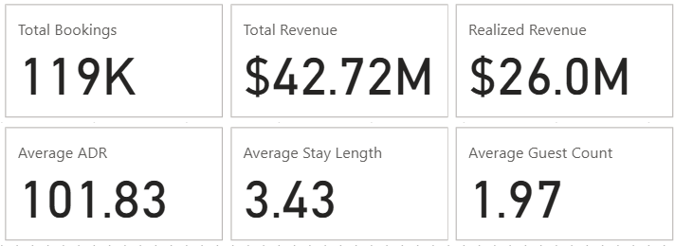
Booking & Revenue Overview KPIs
Total Bookings: Total number of hotel bookings (~119K), representing overall demand volume.
Total Revenue: Estimated revenue assuming all bookings are fulfilled; represents total business potential.
Realized Revenue: Actual earnings from non-canceled bookings, showing true revenue after cancellations.
Average Daily Rate (ADR): Average revenue earned per occupied room — a core pricing performance metric.
Average Stay Length: Average number of nights guests stay (~3.43), used to understand occupancy duration.
Average Guest Count: Average booking party size (~1.97 guests), useful for occupancy and room allocation planning.

Slide 17
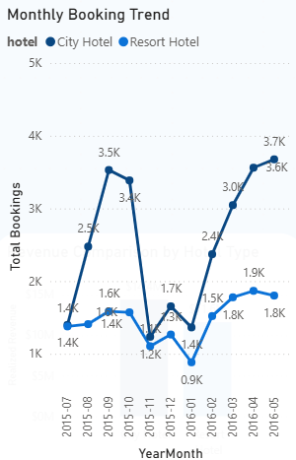
Monthly Booking Trend
Insights
City Hotels consistently outperform Resort Hotels, showing 2× higher monthly bookings across all periods.
Both hotels show strong seasonality, with peak bookings during Oct–Nov and Apr–Jun, indicating high-demand travel seasons.
Resort Hotels have smoother, more stable demand, whereas City Hotels show sharp rises and drops driven by business travel cycles.
Recommendations
Boost pricing & promotions during peak months (Oct–Nov, Apr–Jun) to maximize revenue from high-demand periods.
Introduce targeted off-season offers, especially for Resort Hotels (packages, discounts) to lift low-season months.
Strengthen City Hotel inventory forecasting due to high volatility — adjust room prices and staffing to handle demand spikes.

Slide 18
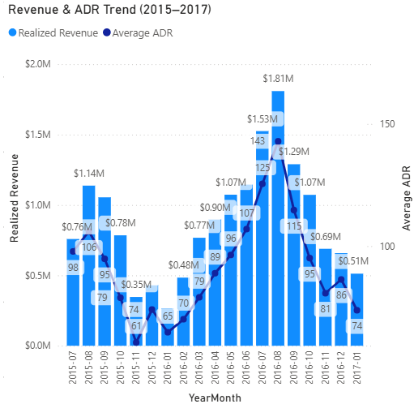
Revenue & ADR Trend
Insights
Revenue consistently peaks during Aug–Sep, driven by both high booking volume and elevated ADR levels.
ADR strength closely aligns with revenue spikes, showing that higher room prices directly boost revenue performance.
Early months (Jan–Feb) consistently show the weakest performance, with both low demand and low ADR marking the clear off-season.
Recommendations
Leverage high-ADR months (Aug–Sep) with premium pricing bundles and upsell offers to maximize profitability.
Introduce pricing incentives during low-ADR months (Jan–Feb) to boost occupancy without harming annual revenue.
Align marketing spend with ADR trends — invest more during peak revenue months for maximum return on campaigns.

Slide 19
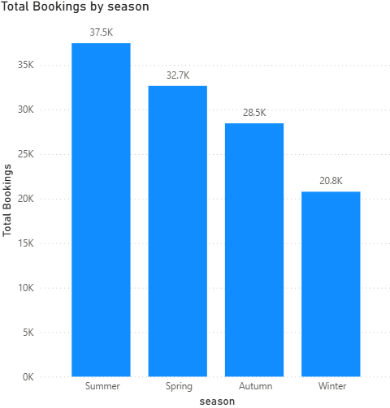
Seasonal Booking Distribution
Insights
Summer receives the highest bookings, showing strong vacation-driven demand.
Spring also performs well, indicating early-year travel momentum.
Winter experiences the lowest demand, and Autumn also trails behind Summer and Spring, confirming the seasonal slowdown.
Recommendations
Increase pricing & premium packages in Summer to maximize revenue during the strongest season.
Run promotional discounts in Winter to boost occupancy during low-demand months.
Adjust staffing & inventory based on seasonality — higher resources in Summer/Spring, lean operations in Winter.

Slide 20
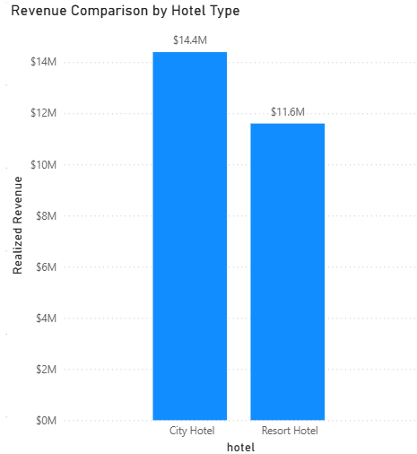
Revenue Comparison by Hotel Type
Insights
City Hotels generate higher realized revenue ($14.4M) than Resort Hotels ($11.6M), driven by stronger booking volume and higher-priced stays.
Resort Hotels still contribute significantly, indicating stable demand for leisure-oriented stays.
City Hotels likely benefit from business-oriented demand and more consistent year-round occupancy, helping them outperform Resorts in overall revenue
Recommendations
Expand premium business packages for City Hotels to strengthen their already dominant revenue performance.
Introduce seasonal upsell programs for Resort Hotels (spa packages, family bundles) to close the revenue gap.
Balance marketing spend—allocate more budget to boosting Resort Hotel occupancy during shoulder seasons.

Slide 21
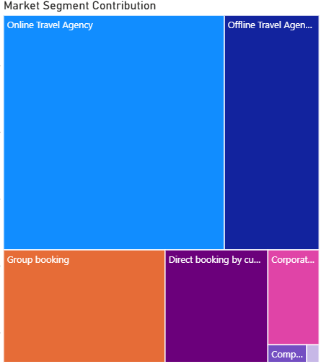
Market Segment Contribution
Insights
Online Travel Agencies (OTA) dominate bookings, capturing the largest share and acting as the primary demand driver.
Offline Travel Agencies form the second-largest segment, followed by Group bookings, reflecting strong leisure and tour-operator-driven travel.
Direct and Corporate bookings form a smaller share, indicating lower brand-direct traction and limited business-travel volume.
Recommendations
Strengthen partnerships with top OTA platforms to maintain high visibility and secure peak-season volume.
Launch exclusive direct-booking benefits (discounts, upgrades, reward points) to grow low-cost, high-margin direct bookings.
Expand corporate & group deals by offering packaged meeting/event rates to boost underperforming segments.

Slide 22
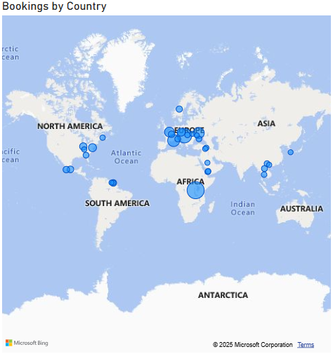
Bookings & Revenue by Country
Insights
European countries contribute the largest share of both bookings and revenue, showing strong travel demand from this region.
North America and South America show moderate contribution, indicating steady but smaller inflow compared to Europe.
Asia and Africa contribute lower volumes, reflecting emerging or less frequent travel patterns to the destination.
Recommendations
Increase targeted promotions in high-performing European countries to strengthen demand and maximize revenue.
Develop region-specific marketing campaigns in North & South America to grow mid-tier markets further.
Explore partnerships in Asia and Africa to tap into emerging travel segments and capture new customer bases.

Slide 23
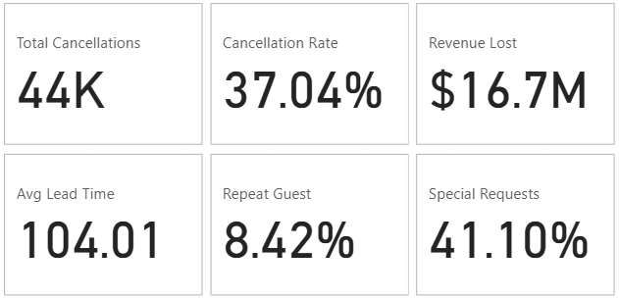
Guest Behaviour & Cancellation KPIs
High cancellation volume (44K cancellations) signals a major leakage point, directly impacting occupancy and revenue stability.
Cancellation Rate of ~37% indicates more than 1 in 3 bookings get canceled — a strong warning for demand forecasting & revenue planning.
Revenue Lost: $16.73M, highlighting the financial impact of cancellations on hotel profitability.
Average Lead Time is 104 days, showing guests book well in advance, increasing the window where cancellations can occur.
Repeat Guests are only 8.4%, showing weak customer retention and limited loyalty behavior.
41% of guests place Special Requests, indicating high expectations and the need for personalized service.

Slide 24
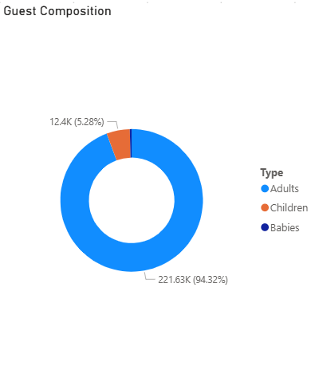
Guest Composition Breakdown
Insights
Adults dominate the guest population (94%), showing that bookings are primarily driven by adult travelers.
Children account for ~5%, indicating moderate family-oriented stays.
Babies account for less than 1%, indicating very low demand for infant-specific amenities.
Recommendations
Prioritize adult-centric services (premium rooms, business amenities, leisure add-ons), as adults form the core revenue base.
Enhance family-friendly offerings (kids’ meals, family packages) to grow the Children segment.
Optional low-cost baby amenities (cribs, baby toiletries) can improve satisfaction for the tiny Baby segment without major investment.

Slide 25
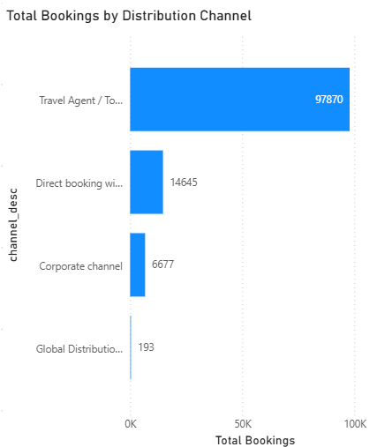
Booking Distribution by Channel
Insights
Travel Agents/Tour Operators dominate bookings (97K+), making them the hotel’s strongest acquisition channel.
Direct bookings are second-highest, but still far below OTA/agent numbers, so the hotel has only moderate brand trust and big scope to increase direct traffic.
Corporate and GDS channels contribute minimally, indicating under-leveraged business travel opportunities.
Recommendations
Strengthen partnerships & visibility on top OTA/agent networks to sustain the dominant channel performance.
Boost direct bookings through website discounts, loyalty rewards, and exclusive member benefits.
Develop targeted corporate deals & GDS promotions to expand low-performing but high-value business segments.

Slide 26
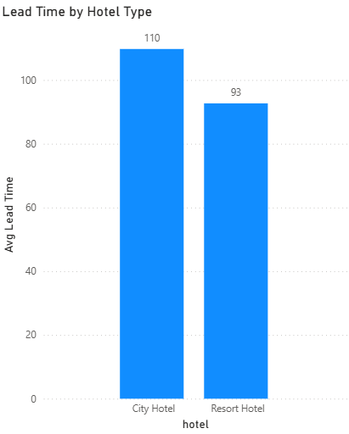
Lead Time Comparison by Hotel Type
Insights
City Hotels have a higher average lead time (110 days), indicating guests tend to book much earlier, often for planned business or long-stay travel.
Resort Hotels show a shorter lead time (93 days), suggesting more spontaneous travel, such as vacations and leisure trips.
The long booking window increases cancellation risk, especially for City Hotels due to early planning and uncertain schedules.
Recommendations
For City Hotels, stricter policies help reduce cancellations because long lead times increase the chance of plan changes.
Run early-bird promotions for Resort Hotels to encourage guests to book sooner and stabilize demand.
Optimize pricing by lead time — higher rates for last-minute bookings and structured discounts for early planners.

Slide 27
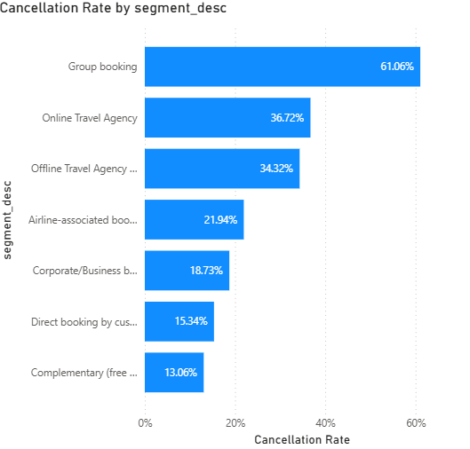
Cancellation Rate by Market Segment
Insights
Group bookings show the highest cancellation rate (~61%), indicating high volatility and limited commitment from large travel groups.
Online Travel Agencies (36%) and Offline Travel Agencies (34%) display elevated cancellation risk due to flexible policies and price-sensitive customers.
Direct & Corporate bookings have the lowest cancellation rates (~15–18%), reflecting stronger intent and more reliable demand.
Recommendations
Tighten cancellation policies for Group & OTA bookings (advance deposits, stricter deadlines) to reduce last-minute losses.
Promote incentives for Direct Bookings (discounts, loyalty rewards) to shift customers toward lower-risk channels.
Strengthen Corporate partnerships through fixed-rate contracts and commitment-based deals to stabilize business demand.

Slide 28
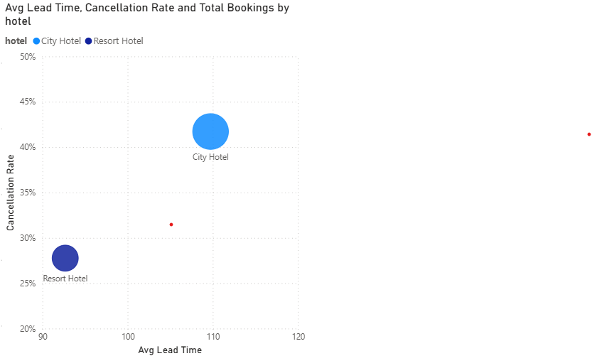
Lead Time vs Cancellation Rate
Insights
City Hotel guests book much earlier (~110 days) but show a higher cancellation rate (~42%), indicating early-planned trips with less commitment.
Resort Hotel guests book closer to the stay (~92 days) and have a lower cancellation rate (~28%), signaling more stable, leisure-driven demand.
Bubble sizes show booking volume — City Hotels have slightly higher volume, but also face higher cancellation risk at longer lead times.
Recommendations
Reduce cancellation risk for City Hotels by tightening policies for long lead-time bookings (advance deposits, stricter cancellation windows).
Encourage more early bookings for Resort Hotels through early-bird discounts and flexible upgrade incentives.
Adopt lead-time–based pricing — premium pricing for last-minute stays, structured discounts for early planners.

Slide 29
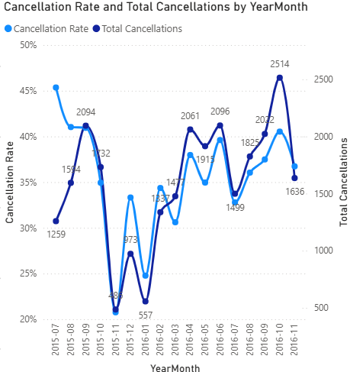
Monthly Cancellation Trends
Insights
Seasonal spikes in cancellations appear in Oct–Nov and Apr–Jun, indicating predictable high-risk periods.
Lowest cancellation months occur in Dec–Jan, showing stronger commitment during holiday travel.
Total cancellations mirror the same pattern as cancellation rate, confirming the trend is driven by real booking volume changes.
Recommendations
Strengthen cancellation rules in peak months (advanced deposits, shorter free-cancellation windows).
Provide off-peak incentives (discounts, flexible upgrades) to stabilize demand.
Use seasonal patterns for staffing & inventory planning to reduce revenue loss and avoid overbooking.

Slide 30
Overall Business Recommendations
Top Improvements:
Optimize cancellation risk management through policy + pricing adjustments.
Build a strong direct-booking ecosystem (loyalty rewards, website offers, exclusive benefits).
Strengthen partnerships with OTA, Corporate, and Group channels based on seasonal demand.
Use seasonal patterns for inventory forecasting and staff allocation.
Scale high-performing segments while applying targeted strategies to revive underperforming ones.
These insights provide a strong foundation for revenue growth, reduced cancellations, and improved guest satisfaction.

Slide 31
Thank You!
Feedback & Suggestions Are Welcome

